Slide 1
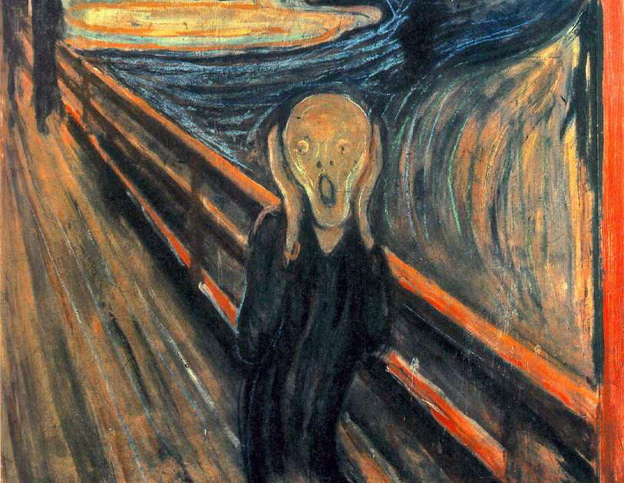
Drought!
How Long Will this Drought Last?
Let’s Look at the Data!
Bill Patzert
wpatzert@jpl.nasa.gov
26 February 2014

Slide 2
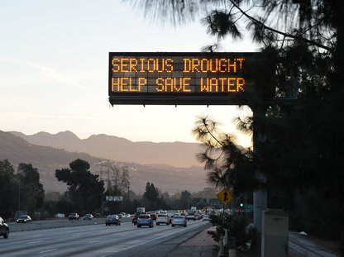

Slide 3
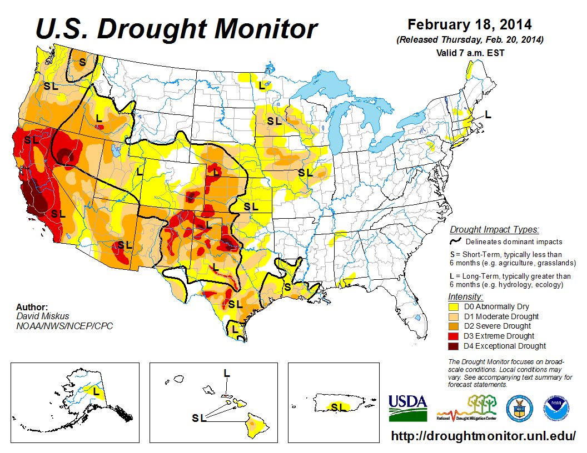

Slide 4
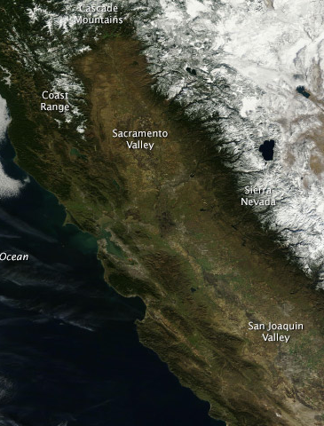
January 18, 2013
January 18, 2014

Slide 5
Record Drought in 2013-2014
• L.A. (CA) Calendar Year 2013
- Jan – Dec = 3.60”
- Driest in 135 yrs
• CA Water/Snow Year 2013 – 2014
- L.A. = 1.20” (~12% of norm, 10.72”)
• Most of West in 3+ year drought
• Drought started in 1999?
- 11 of last 15 years below normal

Slide 6
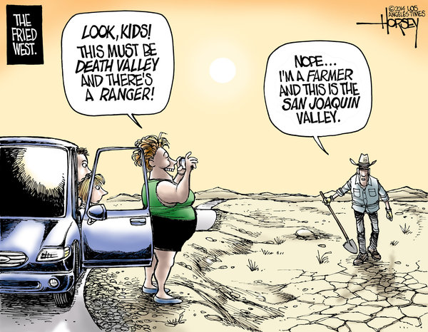
L.A. Resident,
MWD Customer

Slide 7
Why? Pacific Decadal
Oscillation & Drought
Strongly Modulates:
• Precipitation/Snow
• Water Supply
• Global Temperature
• Land & Ocean Ecosystems

Slide 8
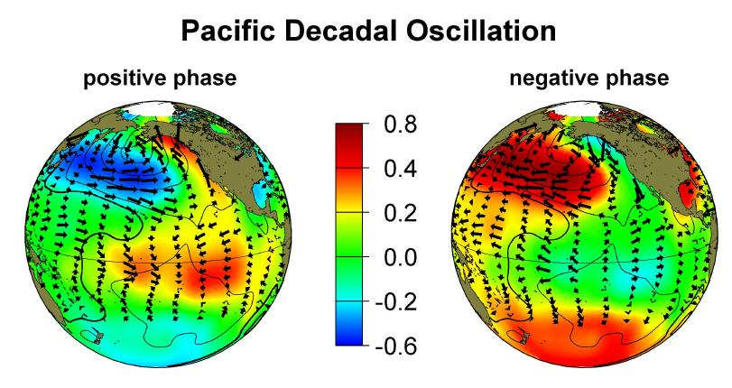
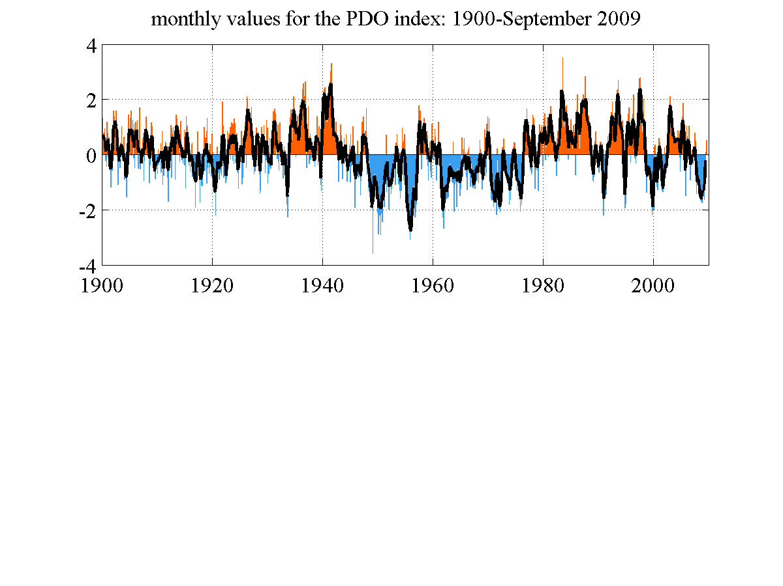
The Pacific Decadal Oscillation Sea Surface Temperature Pattern
Warms Pacific (Earth)
Cools Pacific (Earth)

Slide 9
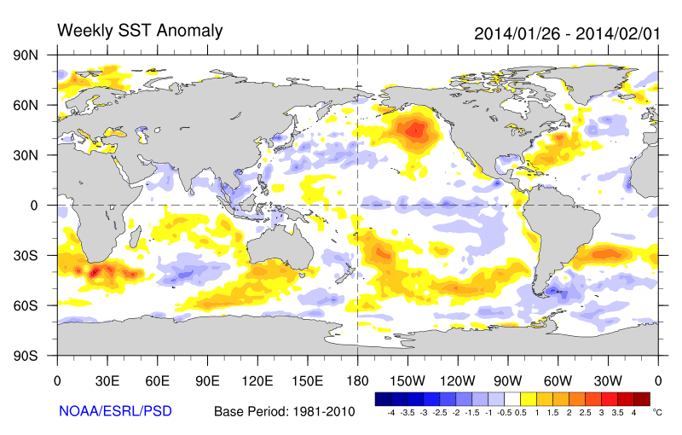

Slide 10
California Precipitation
• No Trend!
• Highly variable
- 38.32” wettest yr (2006–2007)
- 3.21” driest yr (2004–2005)
- 11 of past 16 yrs below ‘normal’
• Strongly Modulated by:
- ‘Events’ (Atmospheric River, 30-70%)
- Interannual (El Niño, La Niña & La Nada)
- Decadal (Pacific Decadal Oscillation)

Slide 11
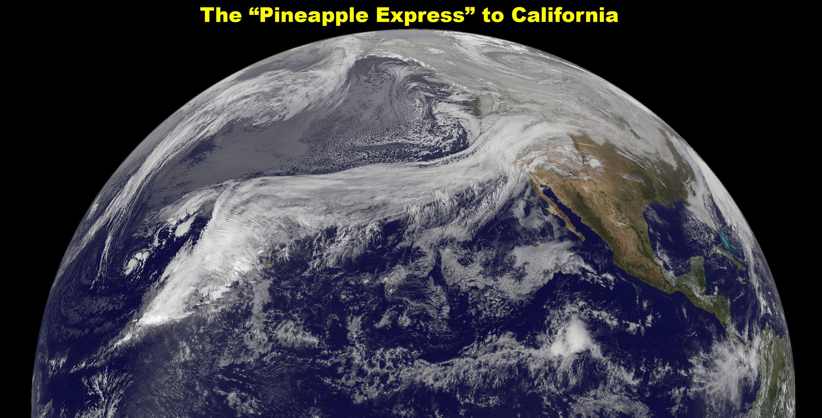
December 2010 ‘Atmospheric River’ Event
Heavy Winter Rains (50% Annual Rain)
13 Wet, Cold Days last two weeks of December ‘10
14.40”at JPL (2.86” normal)
Accounts for 30 to 70%
Of Our Rain & Snow!
Notes:
Lithium Perchlorate salt (old rocket fuel) Super Site

Slide 13
Rain (inches)

Slide 14
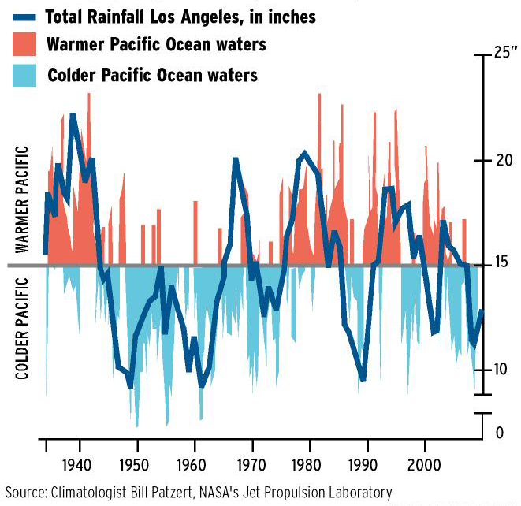
Ocean-driven Drought?

Slide 15
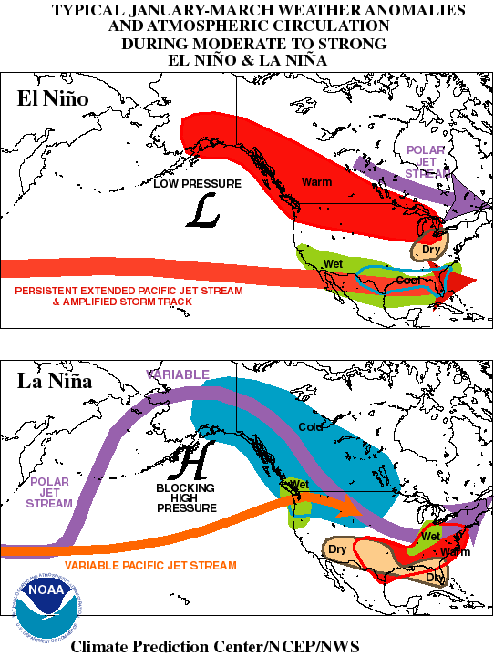
El Niño
Positive PDO
La Niña
Negative PDO

Slide 16
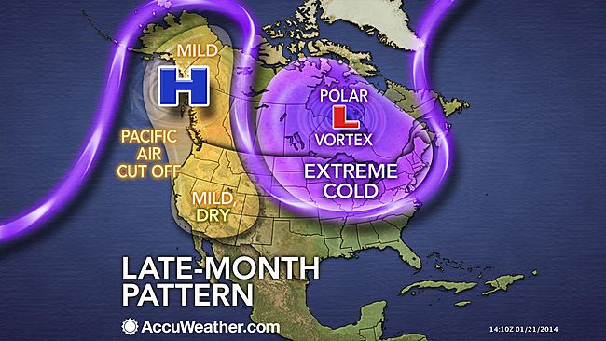
Winter 2013–2014
Jet Stream Pattern
Notes:
This has been the pattern (due to PDO) since November 2013. Atmospheric river broke the pattern in NoCal.
Thus, drought in the West is half the pattern, the severe winter in the Midwest and East is the other half.

Slide 17
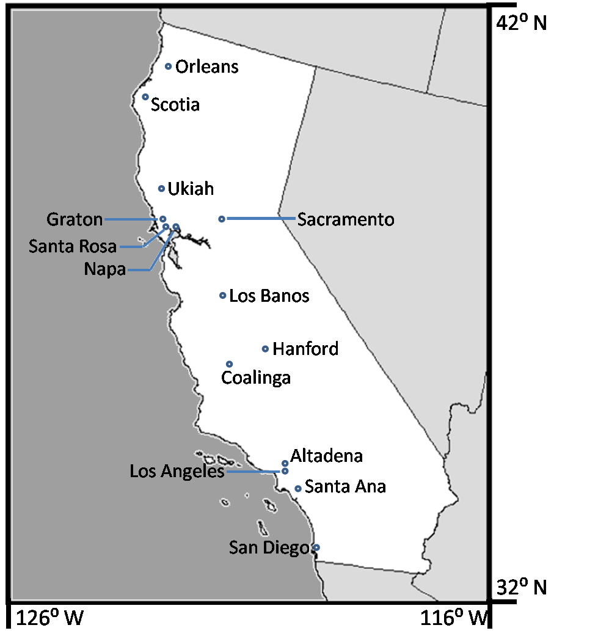
California Rainfall ‘No’ Trends 1925-2007 From NoCal (left) to SoCal (right)

Slide 18
Sacramento & Los Angeles Rainfall (1878 – 2004)
(Yearly, 10 Year Running Mean & Trend)
If trend is 2.5 cm (1”)/century and variability
is similar, trend is significant in ~270 years!

Slide 19
Colorado River

Slide 21
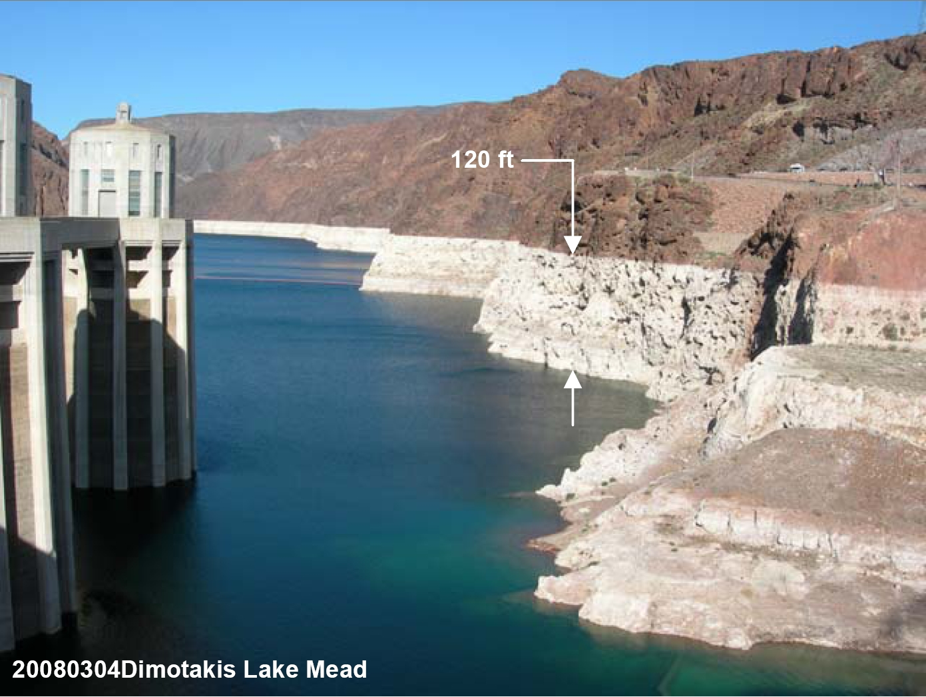
The Pacific Decadal Oscillation
Positive PDO - 1983
Negative PDO - 2014
Notes:
The ring around Lake Mead is the transition from the positive PDO of the ‘80’s and 90’s to the negative PDO beginning with the new century.
Lake Mead is a great barometer of decadal rain trends since it has a fill time of about 17 years.

Slide 22
Anasazi disperse
Notes:
Note all the decadal episodes! Also note that the 20th Century was one of the wettest centuries.

Slide 23
Megadroughts

Slide 24
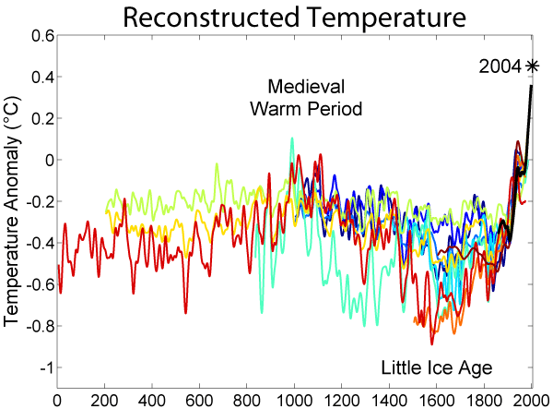

Slide 25
Global Temperature
• Global is Warming (Trend is 0.012°F/yr.)
- CO² increased from 280 to 400 ppm
• Strongly Modulated by:
- ‘Events’ (Weather)
- Interannual (El Niño, La Niña & La Nada)
- Decadal (Pacific Decadal Oscillation)
- PDO Phase Shift causes ‘GW Hiatus’ or
‘GW Acceleration’

Slide 26
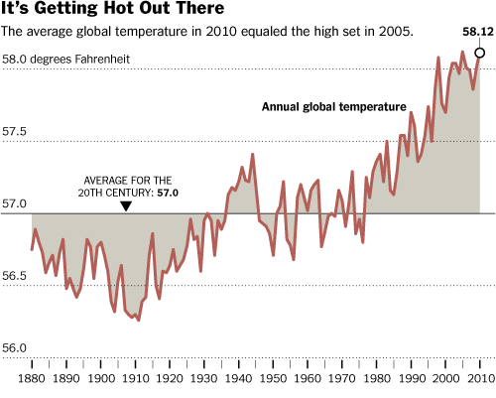
0.012°F/yr.
-PDO
+PDO
-PDO

Slide 27
Global Annual Temperature Anomalies
vs 1951–1980 Average (°C)*
ENSO Modulates Global Temps
*NASA’s Goddard Institute for Space Studies (GISS)

Slide 28
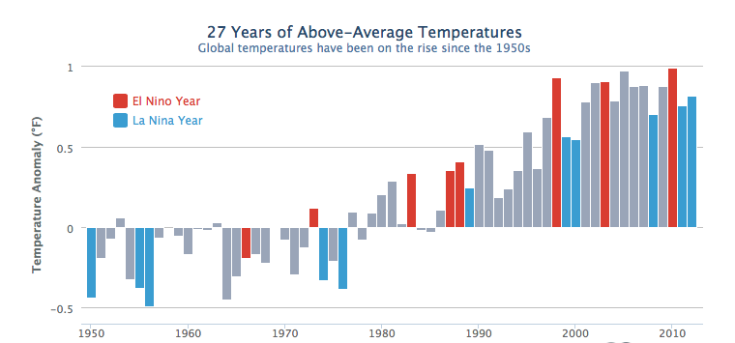
Global Temperature Anomalies since 1950
Pacific Decadal Oscillation Modulates Global Temperatures
Negative PDO = Hiatus
Positive PDO =
Rapid Increase
Negative PDO =
Recent Hiatus

Slide 29
Why Drought?
Pacific Decadal Oscillation
Strongly Modulates:
• Precipitation/Snow
• Water Supply
• Global Temperatures
• Lots of Other Stuff
When Does Drounght End?

Slide 30
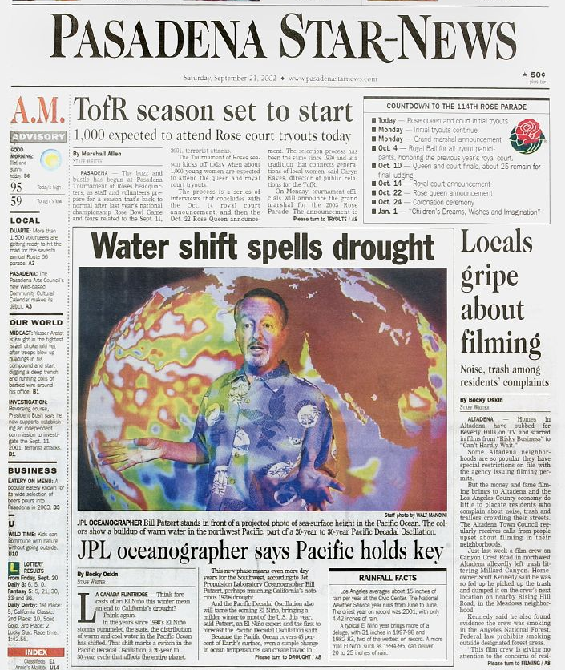
September 21, 2002

Slide 31
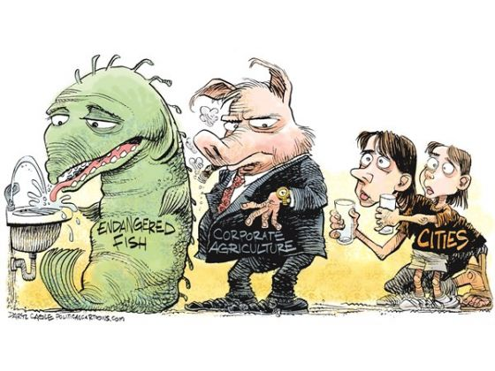

Slide 32
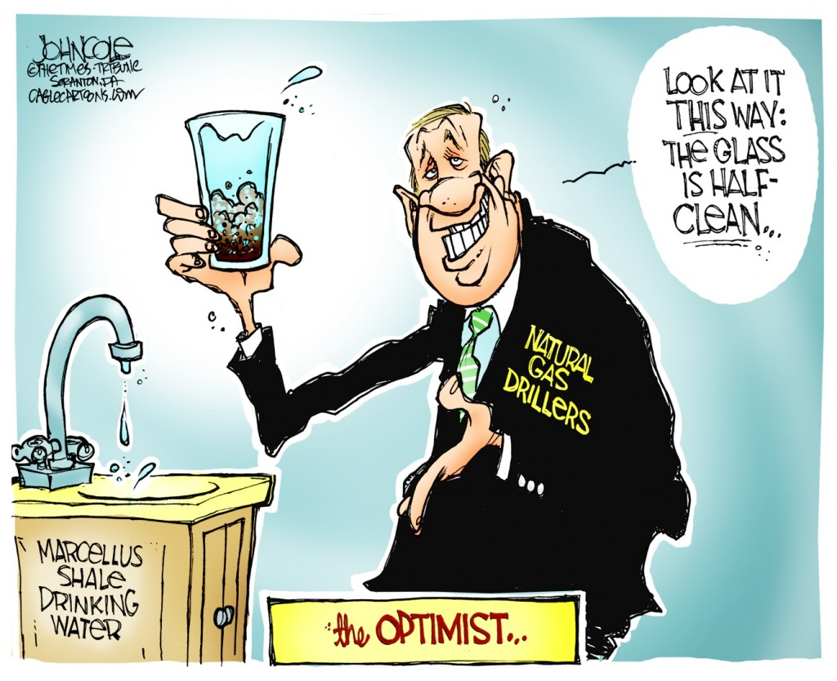
Fracking = H2O
Since 2005, 250 billion gallons H2O
used in 80,000 wells in 17 States!

Slide 33
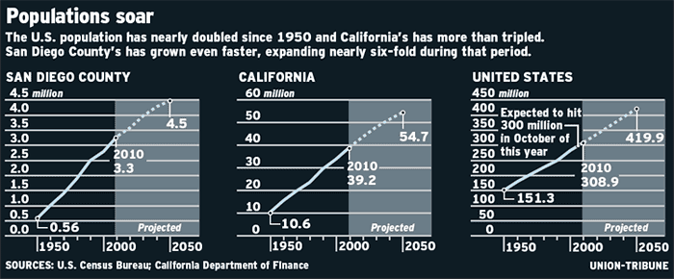
CA Population Explosion
Stresses Everything!
6X 4X 2X

Slide 34
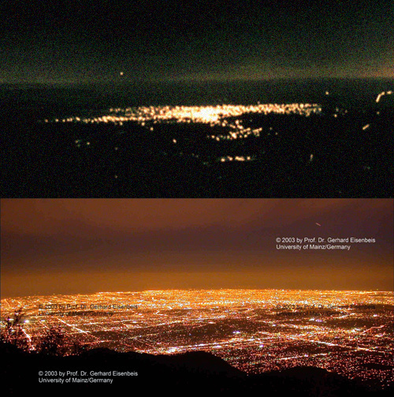
L.A.-1902
It’s us!
L.A.-2010

Slide 35
Managing Water
in Semi-Arid CA
• (Naturally) Varying Climate
• Global Warming Accelerating
• Environment Stressed Out
• Expanding Agricultural Demands
• Growing Urban Population
• Changing Economy
• Technology Explosion
• New Users (Frackers)

Slide 36
Our water management policy is tailored
for more wet years than dry years.
The reality is just the opposite.
Even when nature behaves,
there are too many water demands
to satisfy all of them.
This drought is a great opportunity to start
a real conversation about fundamental changes
in California water policy

Slide 37
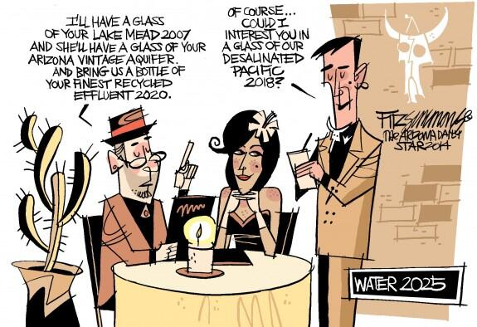

Slide 38
Ignoring Reality = Dire Consequences
What’s your worst nightmare?
• Politicians
• Lawyers

Slide 39
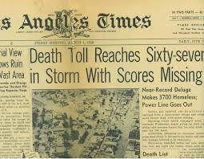
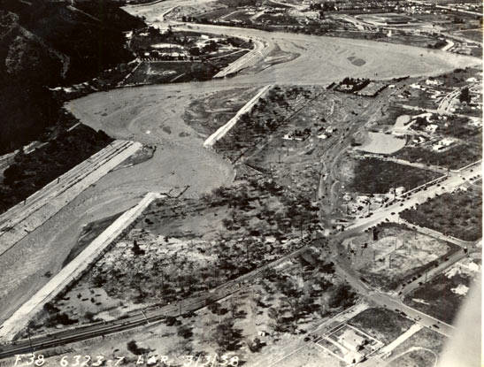
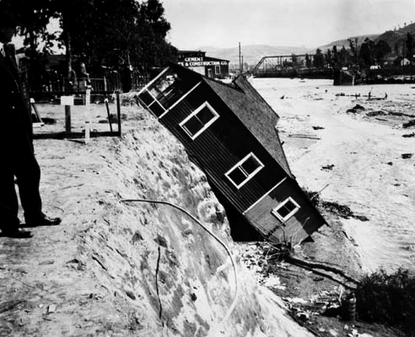
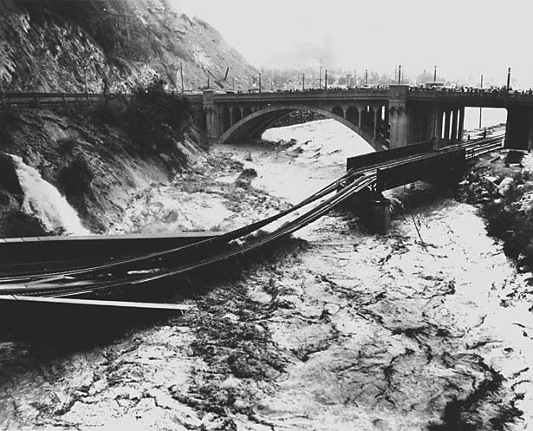
The Great Flood of 1938
76th Anniversary
February 27 – March 4, 1938
~10.0” of Rain

